Slide 1
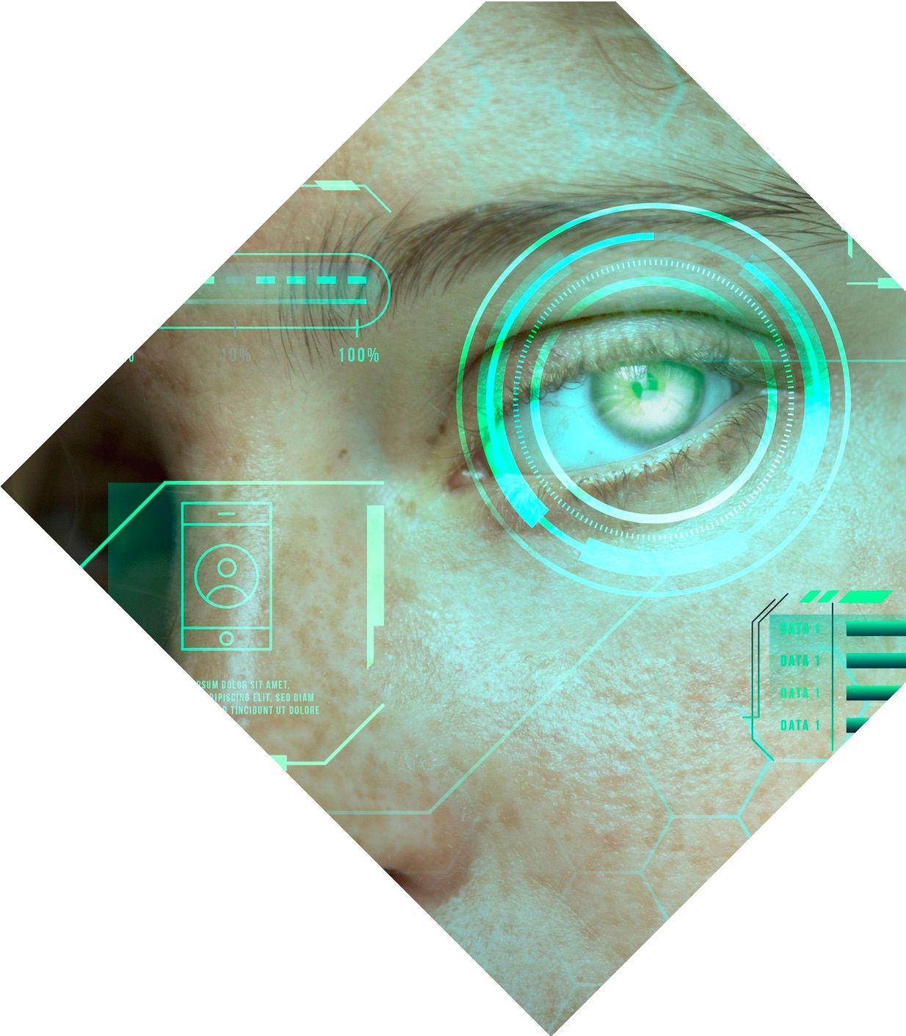
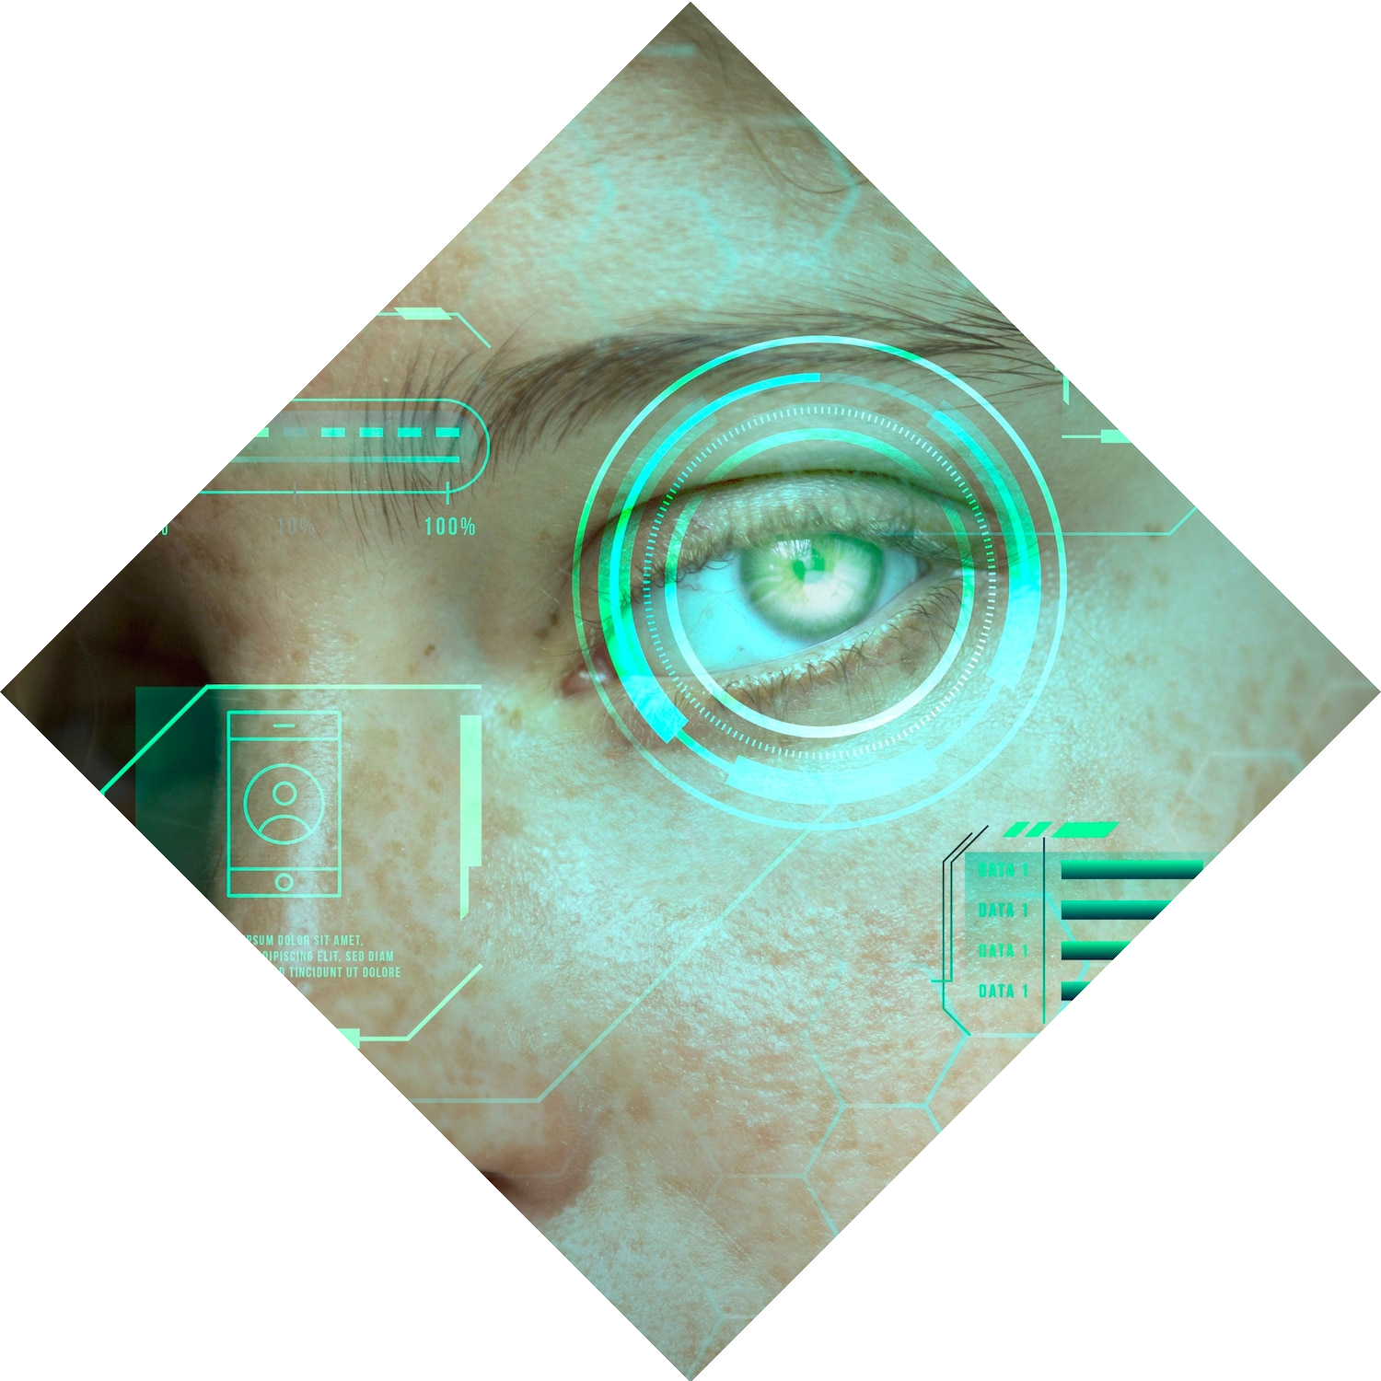
The Lost Student App
Image Retrieval, Image Based Localization Computer Vision Final Project
Ron Haikin
Roy Amoyal
Omri Hirsh

Slide 2
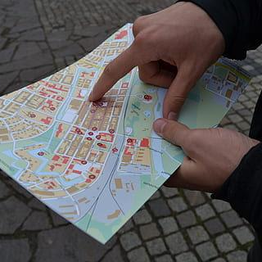

The Problem
Imagine being a freshman at Ben-Gurion University, stepping onto campus with excitement and anticipation,
only to find yourself lost in a maze of buildings, unsure of where your next class is located

Slide 3
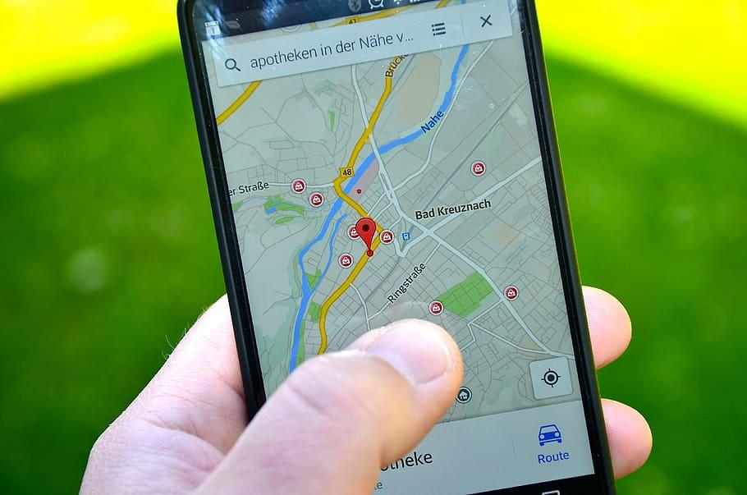
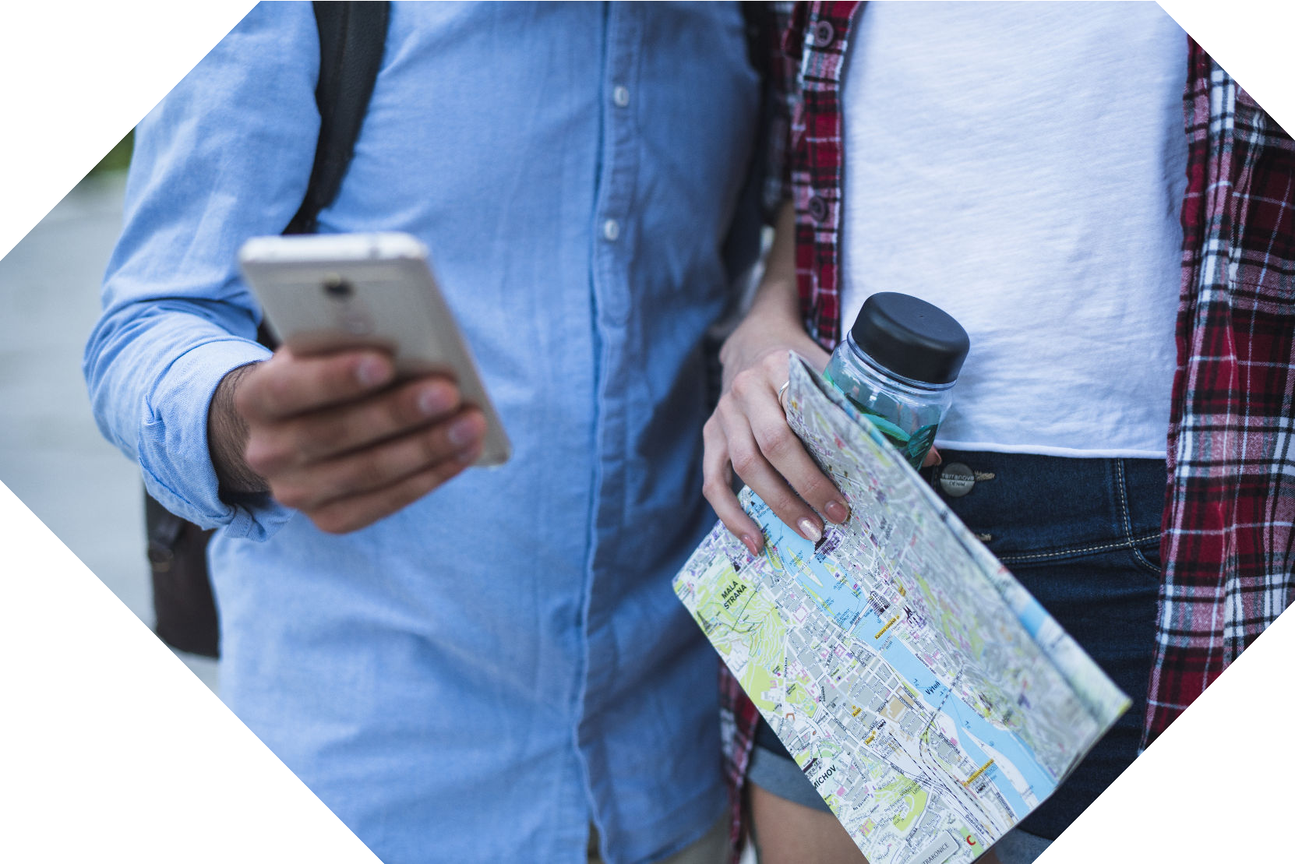
Our Solution
The Lost Student App
Smartphone Camera Based
Easy to use
Navigation Between Buildings

Slide 4
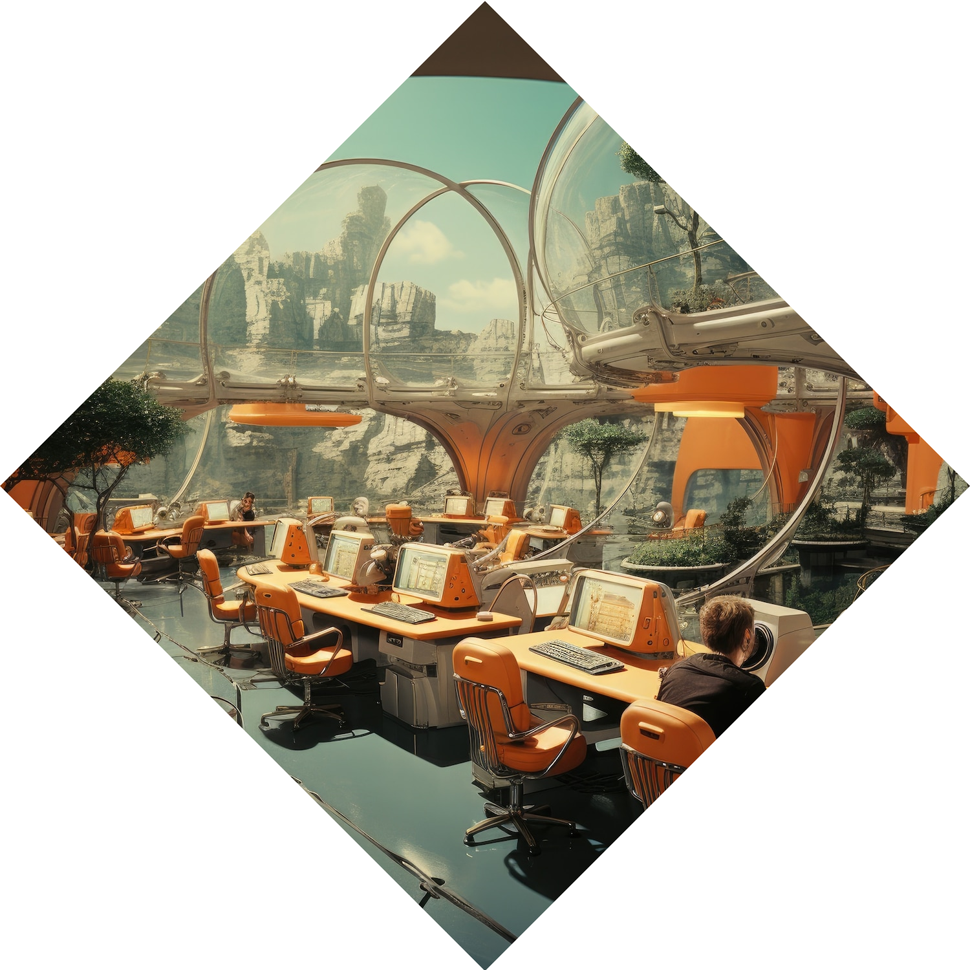
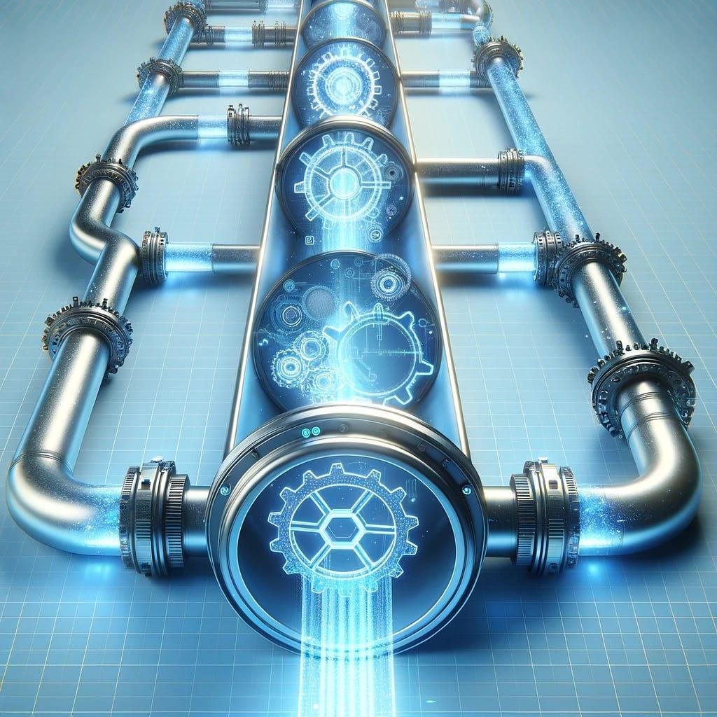
The Pipeline
1
2
Find ‘Features’ in the image
Upload
Image
3
4
Find ‘matching’ between our ‘DB’ to the image
Show the Path on the Map

Slide 5
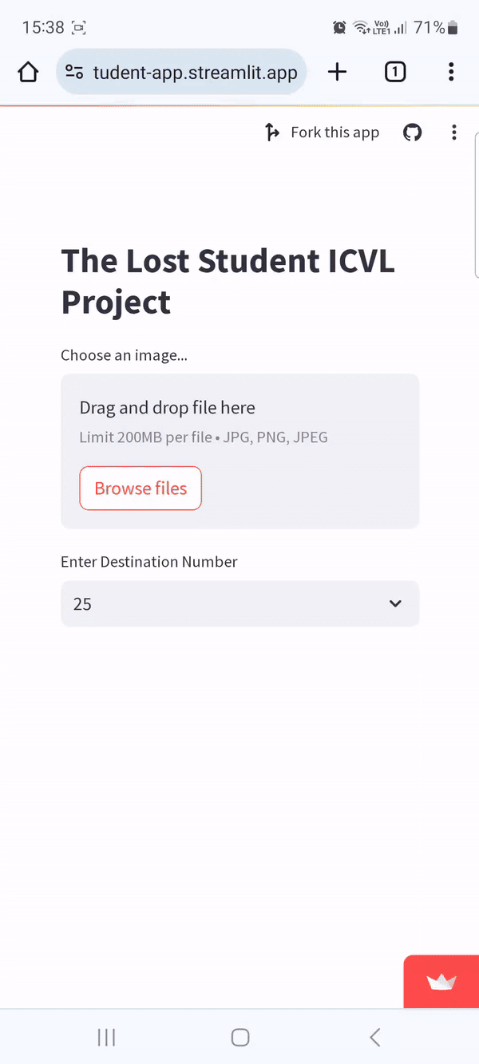
The Pipeline
1
2
Find ‘Features’ in the image
Upload
Image
3
4
Find ‘matching’ between our ‘DB’ to the image
Show the Path on the Map

Slide 6
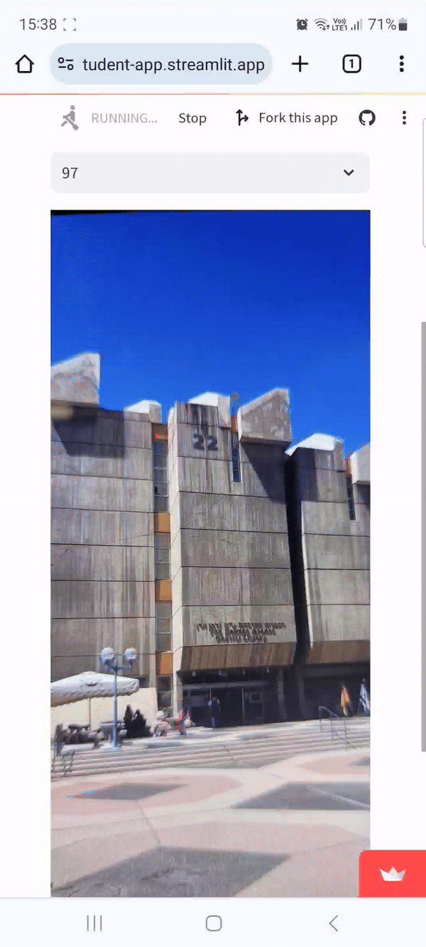
The Pipeline
1
2
Find ‘Features’ in the image
Upload
Image
3
4
Find ‘matching’ between our ‘DB’ to the image
Show the Path on the Map

Slide 7
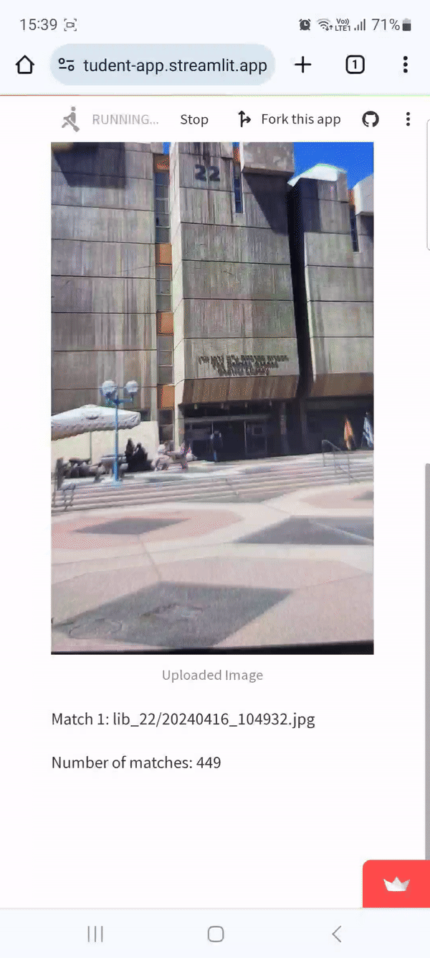
The Pipeline
1
2
Find ‘Features’ in the image
Upload
Image
3
4
Find ‘matching’ between our ‘DB’ to the image
Show the Path on the Map

Slide 8
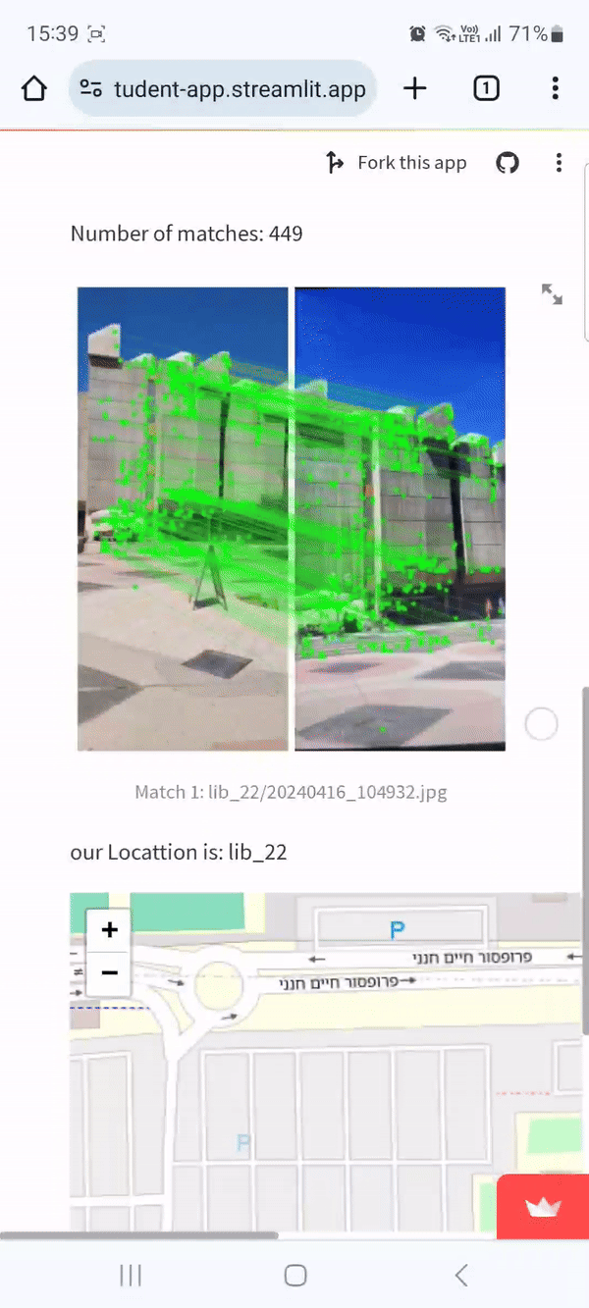
The Pipeline
1
2
Find ‘Features’ in the image
Upload
Image
3
4
Find ‘matching’ between our ‘DB’ to the image
Show the Path on the Map

Slide 9
The Pipeline
1
2
Find ‘Features’ in the image
Upload
Image
3
4
Find ‘matching’ between our ‘DB’ to the image
Show the Path on the Map

Slide 10
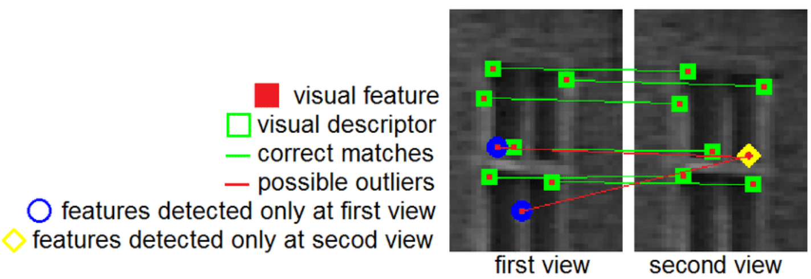
What are features?
Features in an image are distinctive points that represent important visual information, such as corners or blobs.
Descriptors are numerical representations of these features that encode their appearance or surroundings, enabling algorithms to match and compare them efficiently for tasks like object recognition or image stitching.
1
2
Image
Feature
3
4
Matching
Map

Slide 11
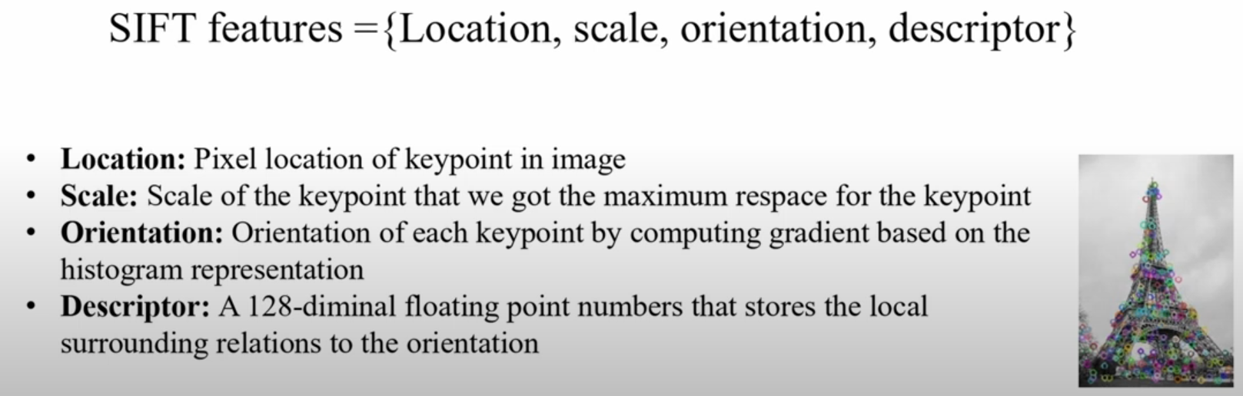
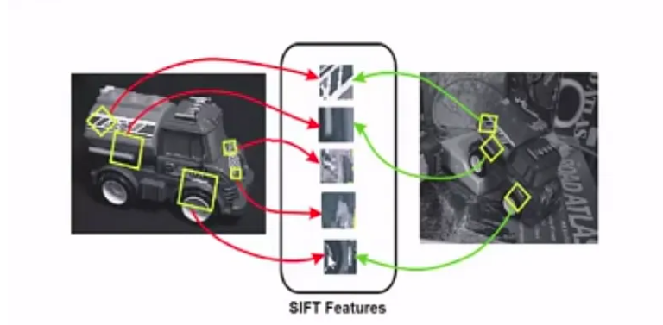
SIFT - Scale Invariant Feature Transform
1
2
Image
Feature
3
4
Matching
Map

Slide 12
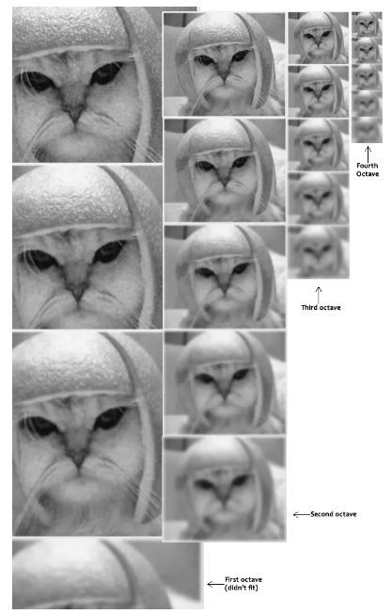
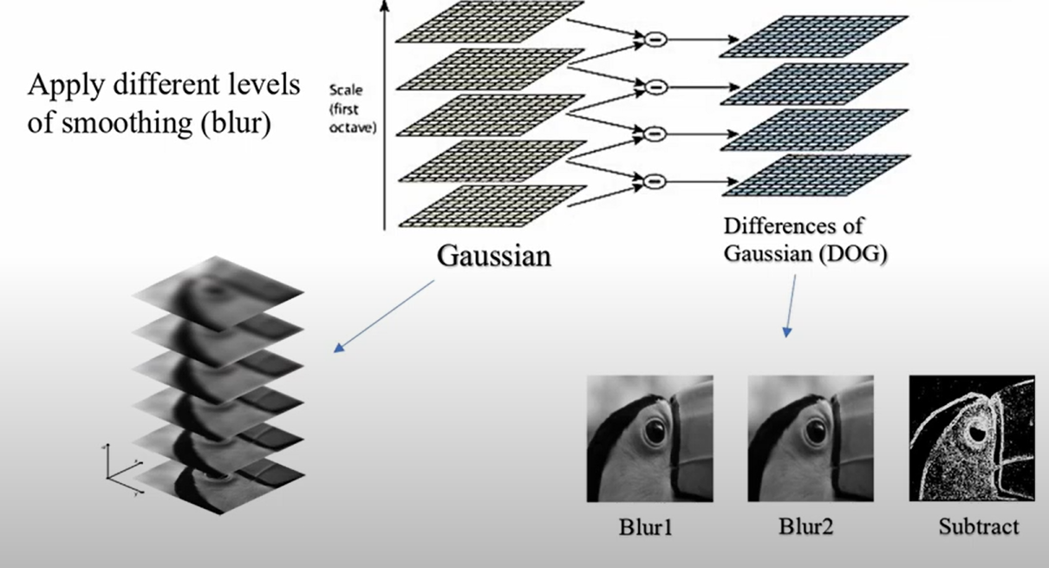
SIFT Workflow
Scale-Space Extrema Detection:
Build a scale space by applying Gaussian blurring and downsampling the image.
1
2
Image
Feature
3
4
Matching
Map

Slide 13
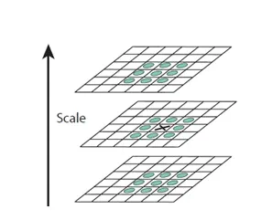
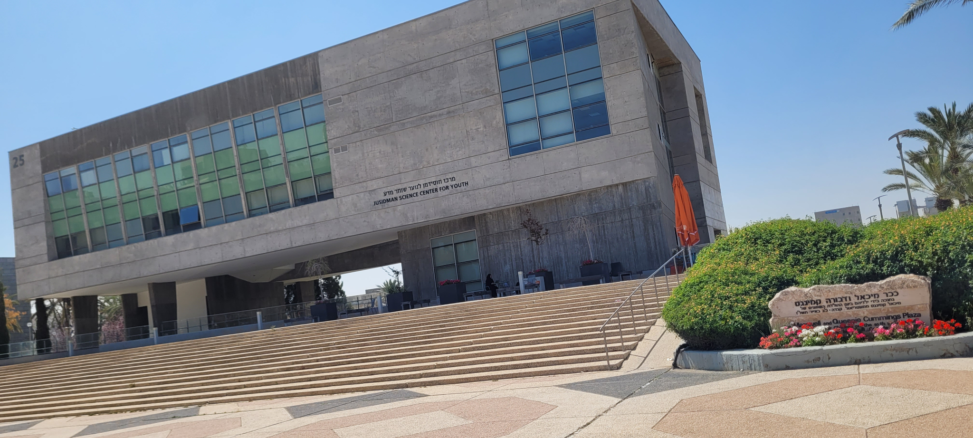
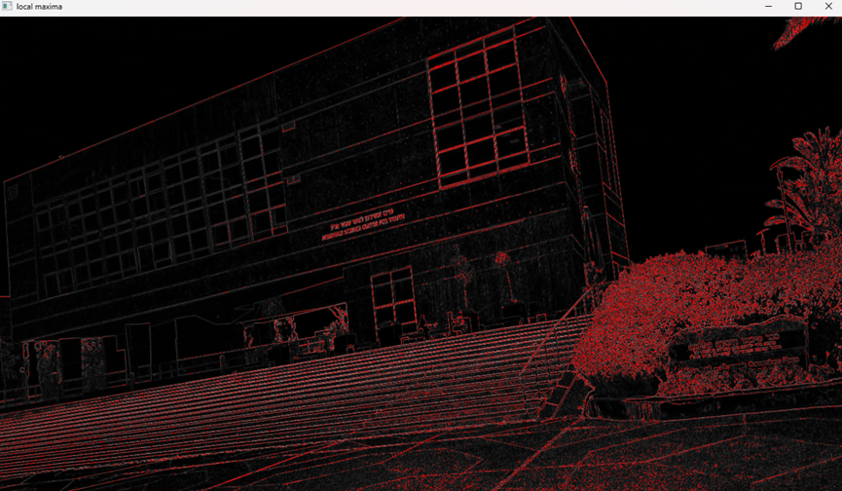
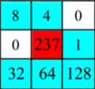
SIFT Workflow
Scale-Space Extrema Detection:
Detect potential keypoints (extrema) across scales by comparing each pixel with its neighbors.
1
2
Image
Feature
3
4
Matching
Map

Slide 14
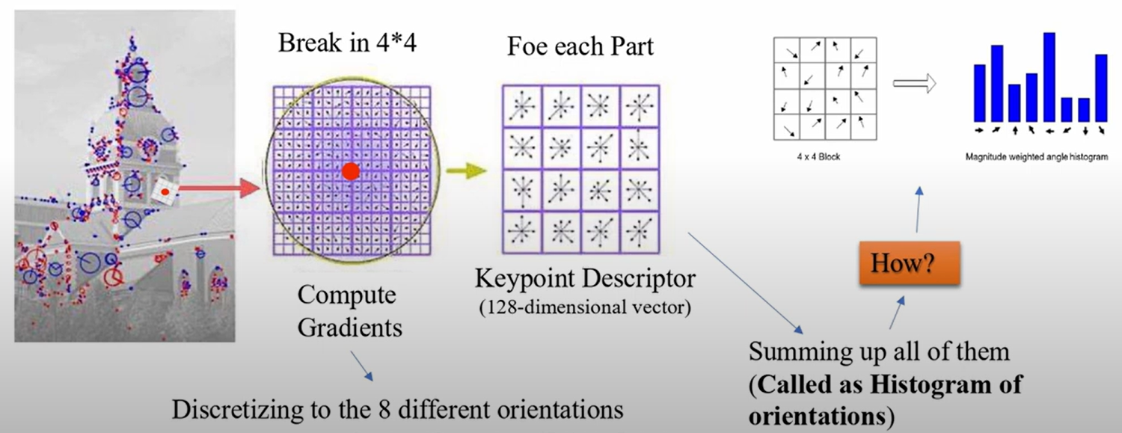
SIFT Workflow
Keypoint descriptor:
Generate a feature descriptor vector for each keypoint based on local image gradients.
1
2
Image
Feature
3
4
Matching
Map

Slide 15
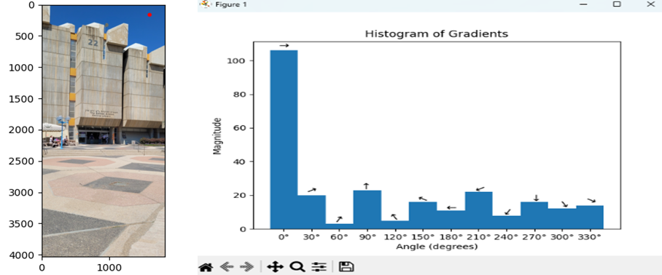
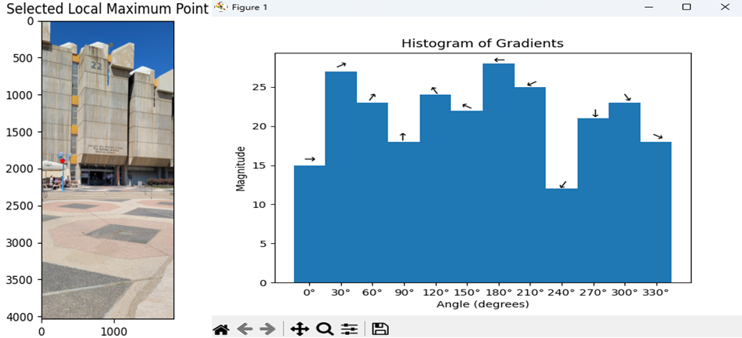
SIFT Workflow
Orientation Assignment:
Compute gradients orientations histograms around each keypoint and assign a dominant orientation.
Keypoint descriptors will be invariant to image rotation due to this orientation assignment.
1
2
Image
Feature
3
4
Matching
Map

Slide 16
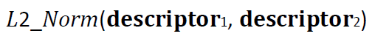
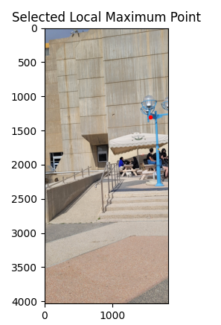
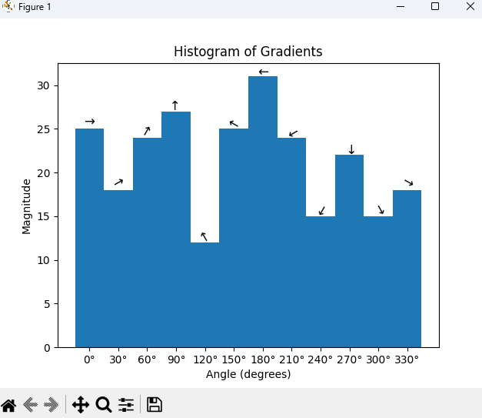
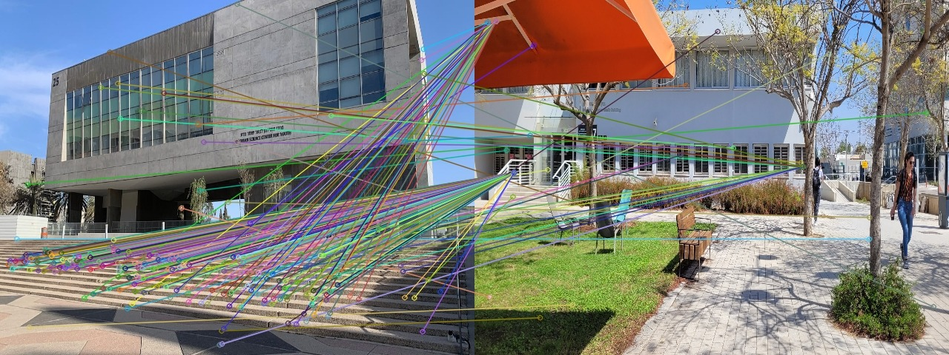
SIFT + Old School Matching Limitations
1
2
SIFT, SURF, ORB, AKAZE and other classic features and descriptors can’t handle different perspectives with the classics matching techniques!
We still want to be able to use them, maybe we can change the matching process?
Image
Feature
3
4
Matching
Map

Slide 17
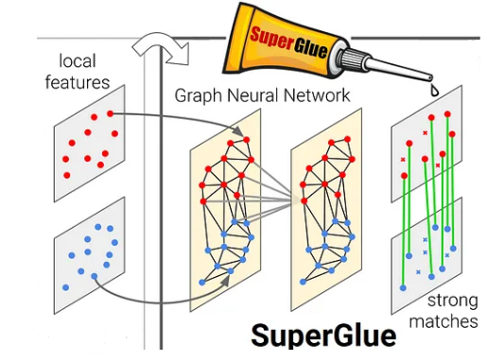
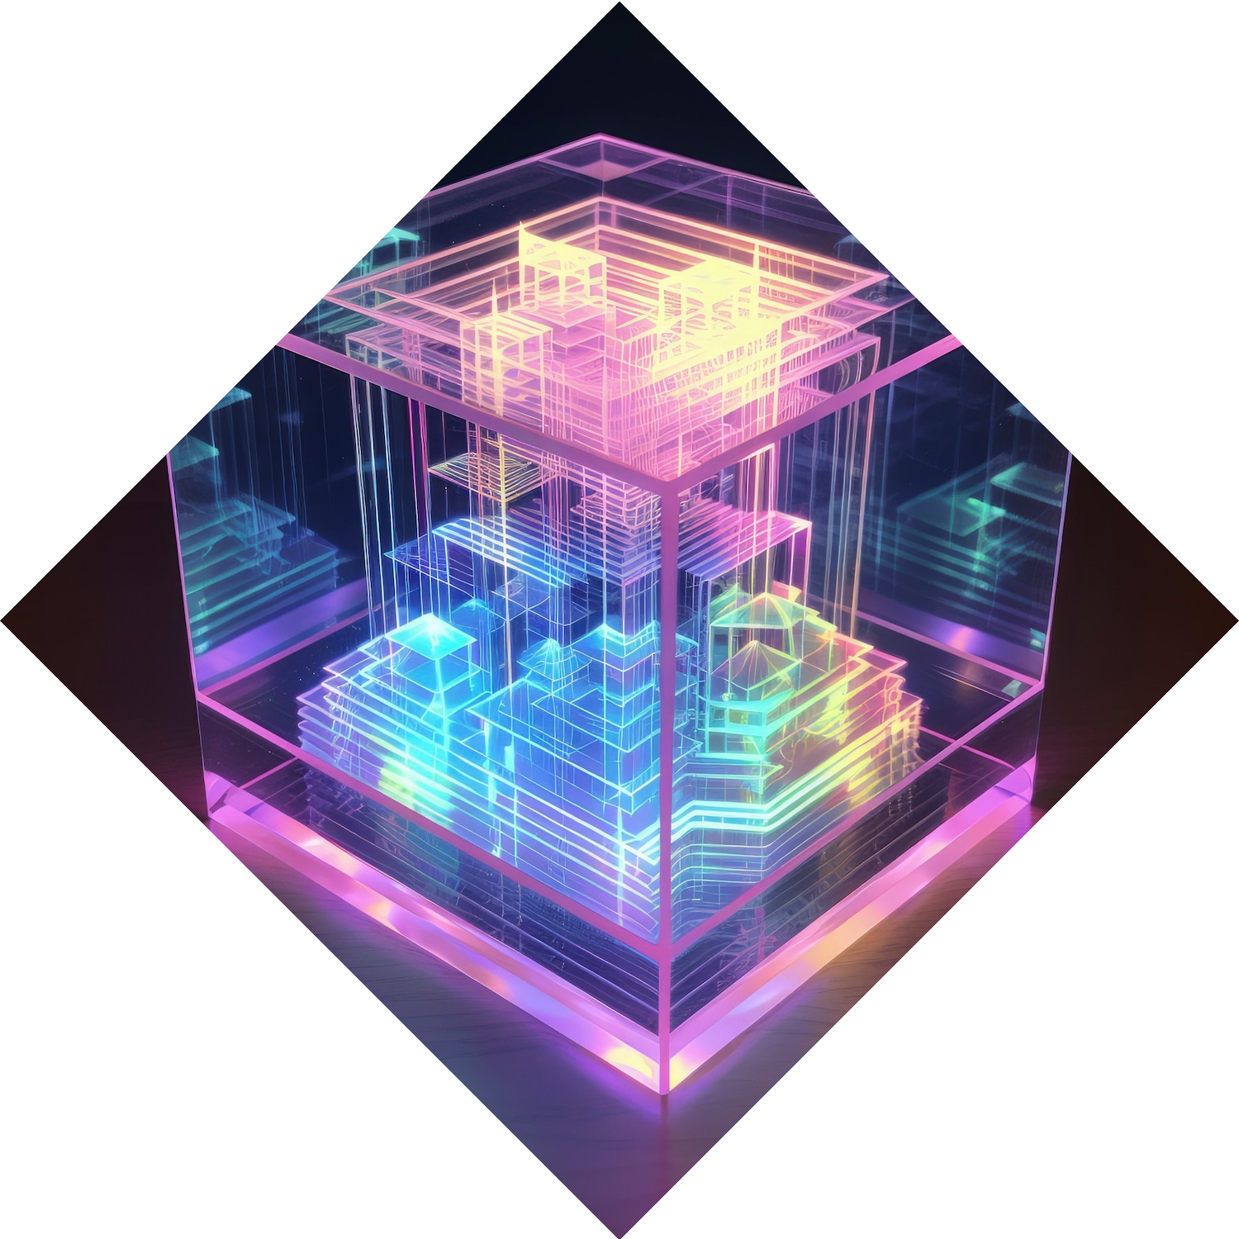
Matching Computation-
Exploring “Light Glue”
Deep neural network for matching keypoints in images
Input: Descriptors Vector 128 Dim - Image1,
Descriptors Vector 128 Dim - Image2
Output: Matching Between the keypoints
An improvement to “SuperGlue”, the previous state-of-the-art method
Achieves high accuracy while being much faster
Adaptively reduces complexity for easy image pairs
1
2
Image
Feature
3
4
Matching
Map

Slide 18
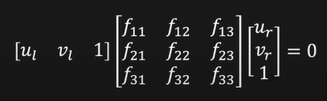
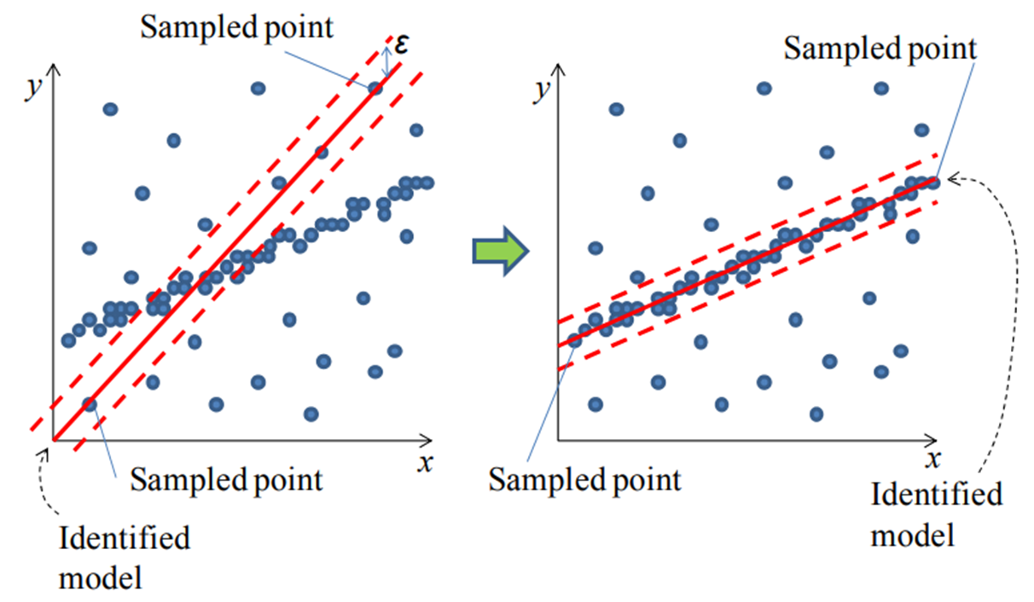
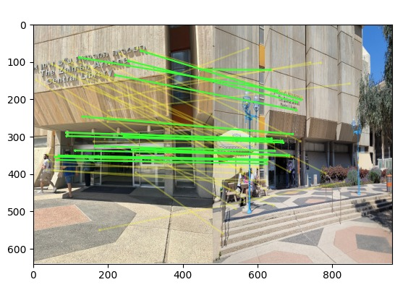
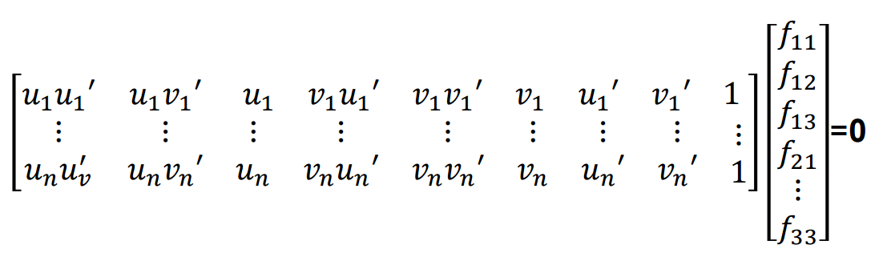
Features matching - Outlier Detection
We used Fundamental matrix that represents a geometric relationship between two images of the same scene taken from different viewpoints.
To compute the Fundamental Matrix, we utilized 2D keypoints matches and applied Robust Linear Least Squares with the RANSAC (Robust Maximum Likelihood Estimation) algorithm.
1
2
Image
Feature
3
4
Matching
Map

Slide 19
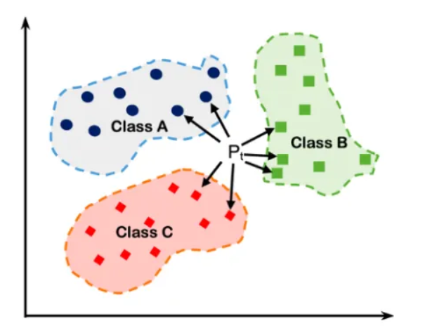
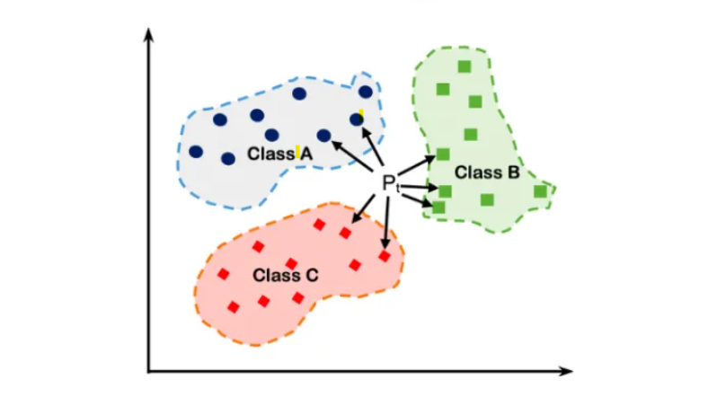
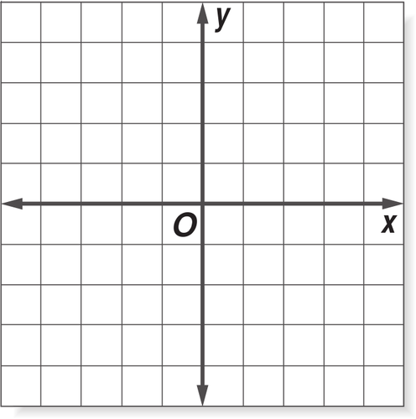
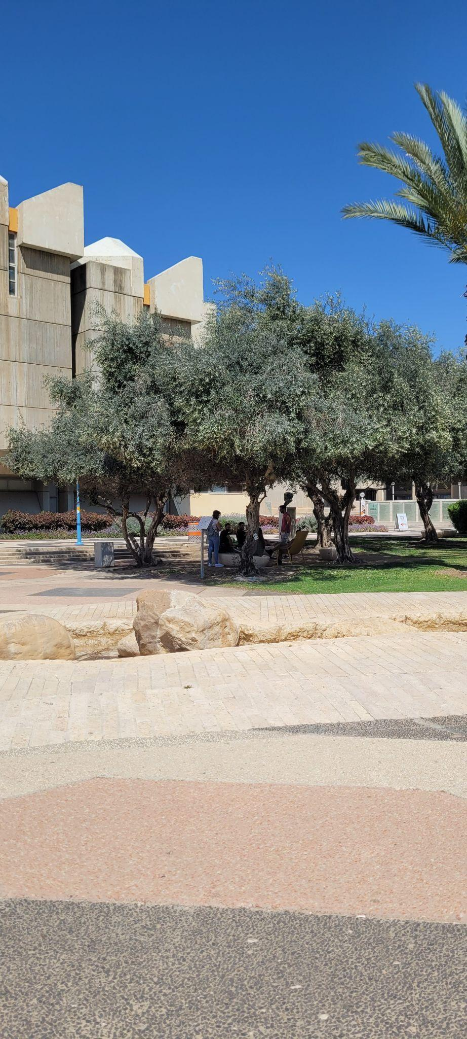
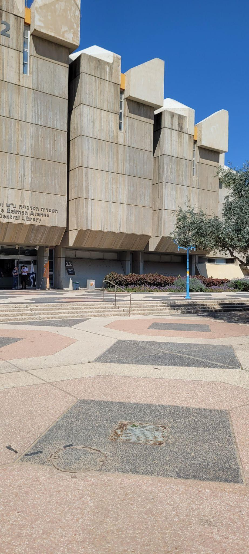
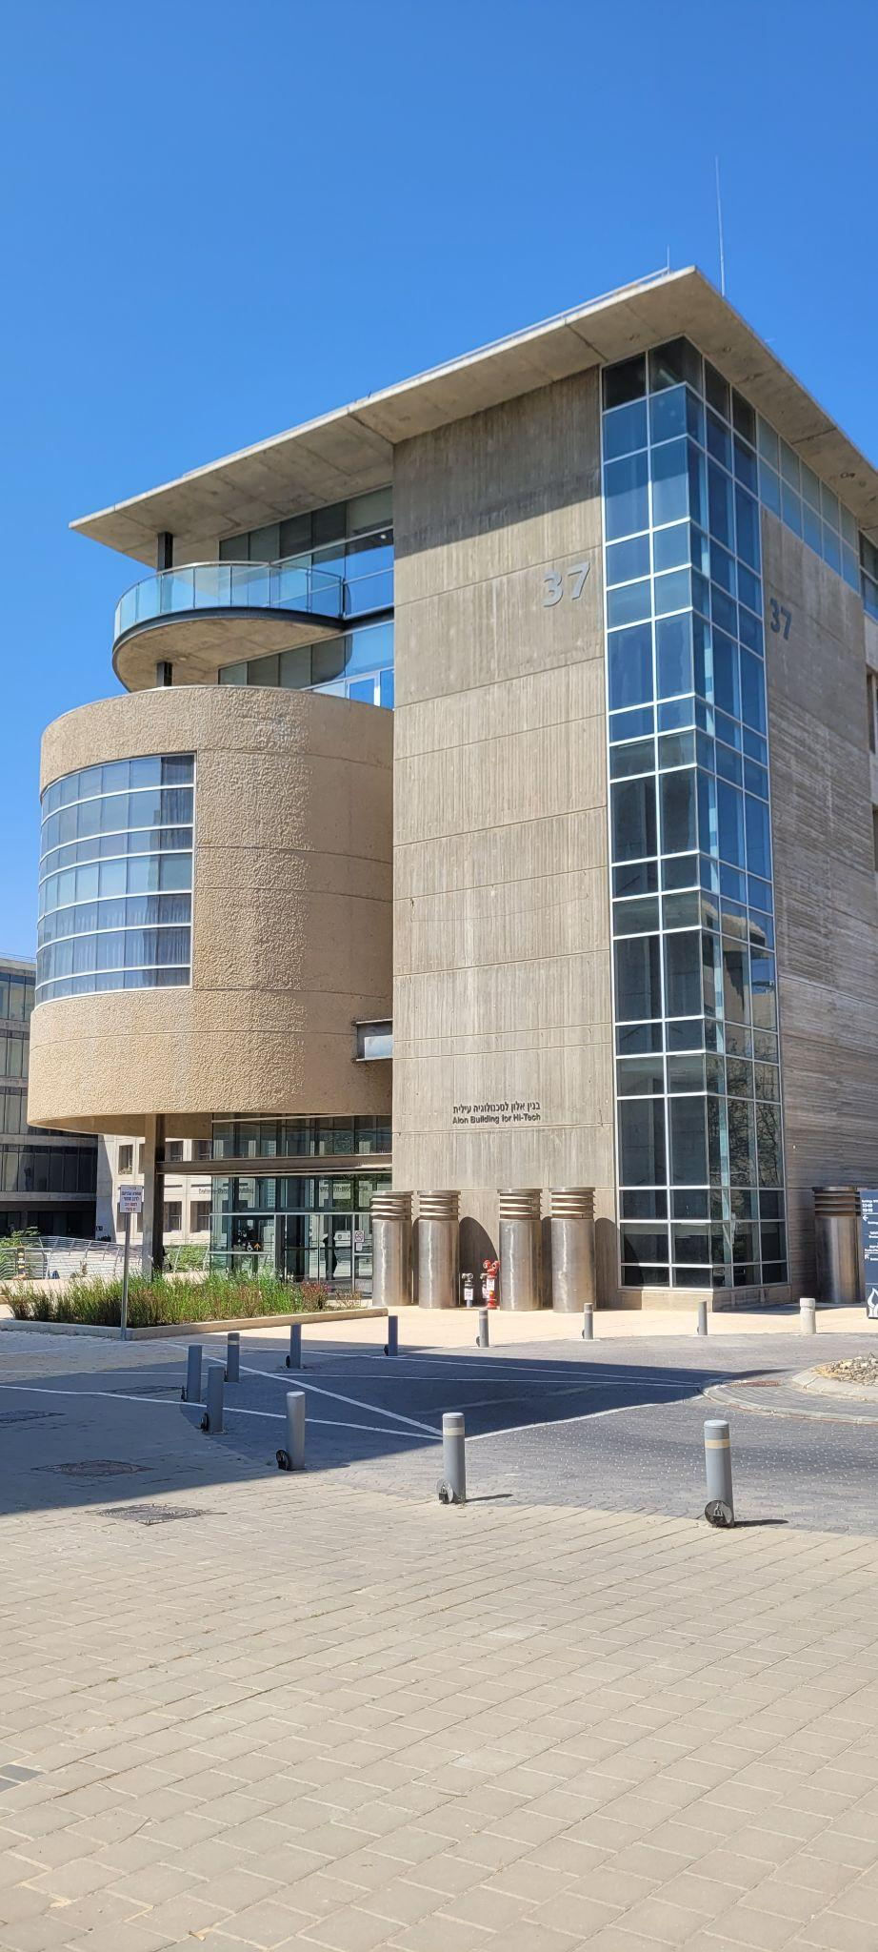
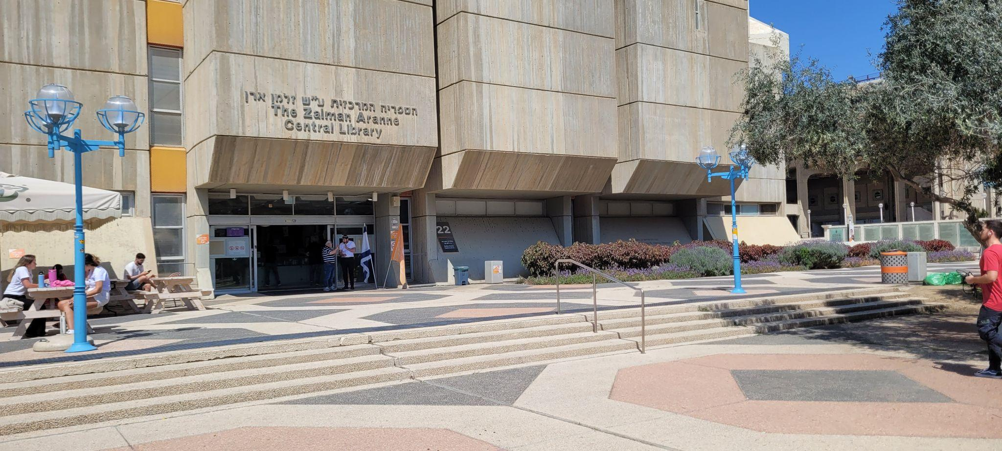
Finding Where You are-
k Nearest Neighbor
Took top k images
By majority vote we choose the building
User Input
Good Ref. in DB
Bad Ref. in DB
1
2
Image
Feature
3
4
Matching
Map

Slide 20
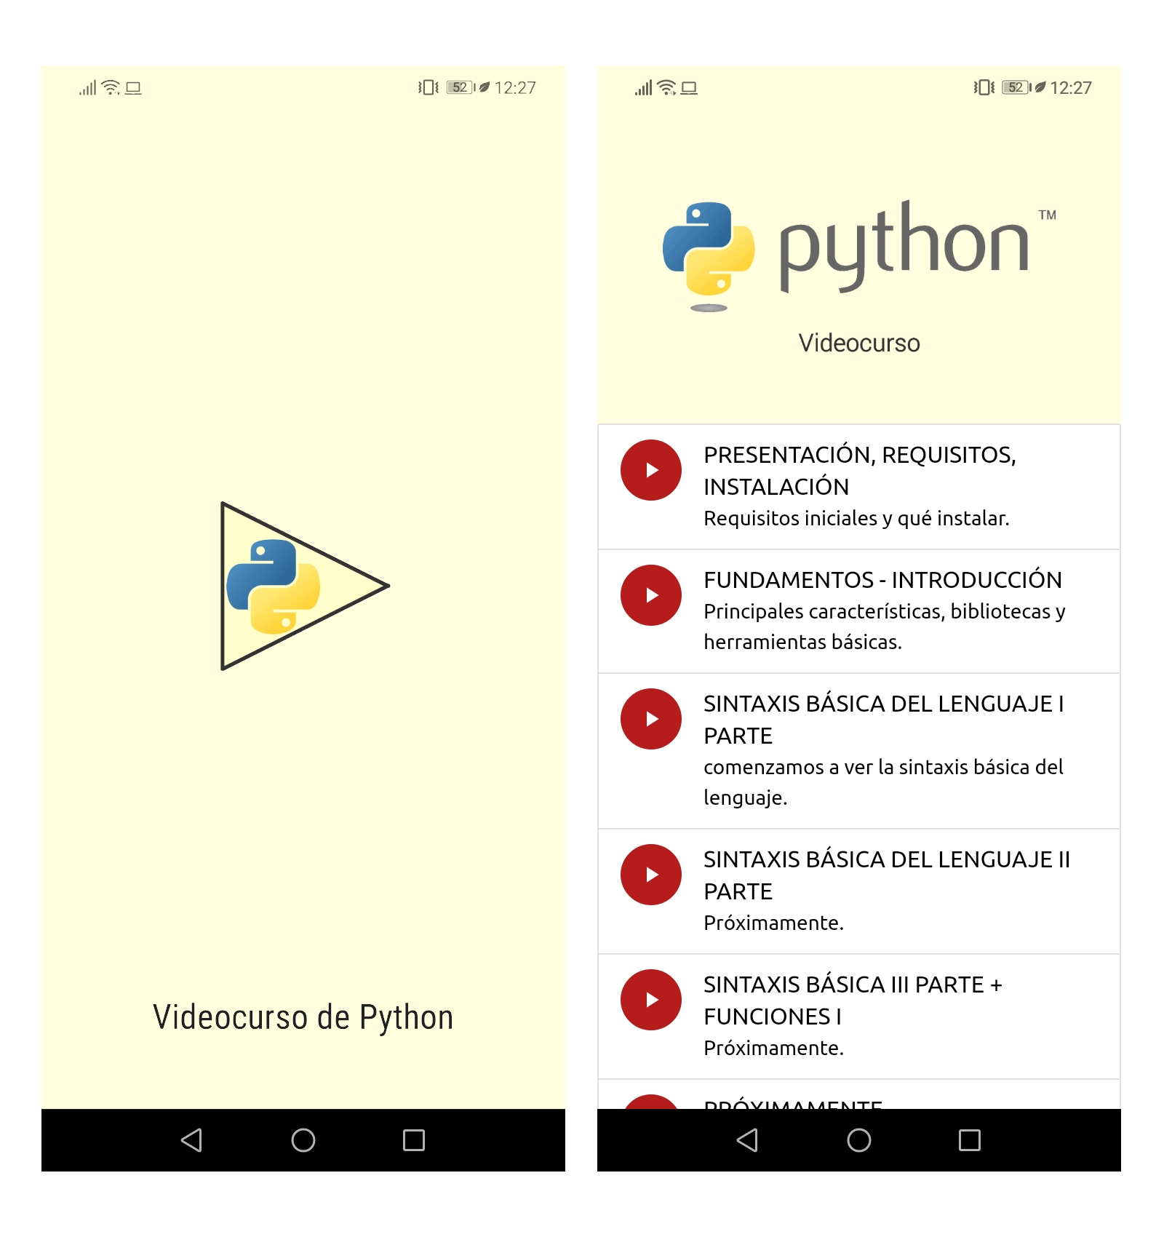

WebApp - Streamlit.io
https://streamlit.io/
Easy to Use
Best for Phone and Computer use
Easy to Program
Python Based

Slide 21
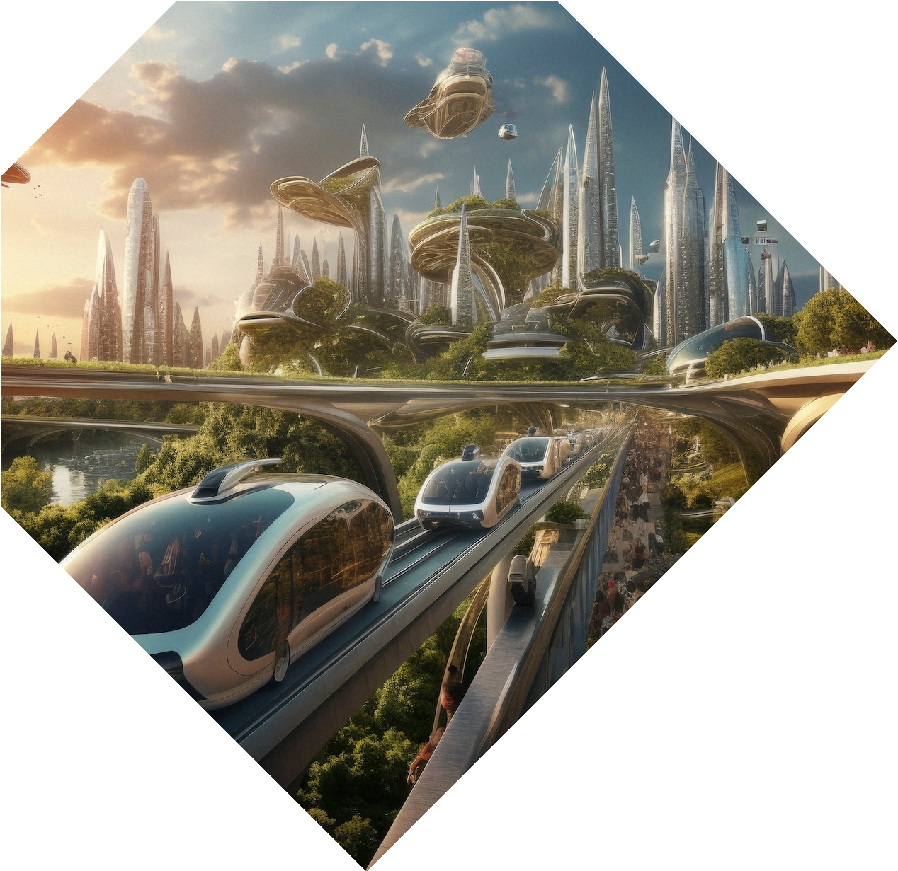
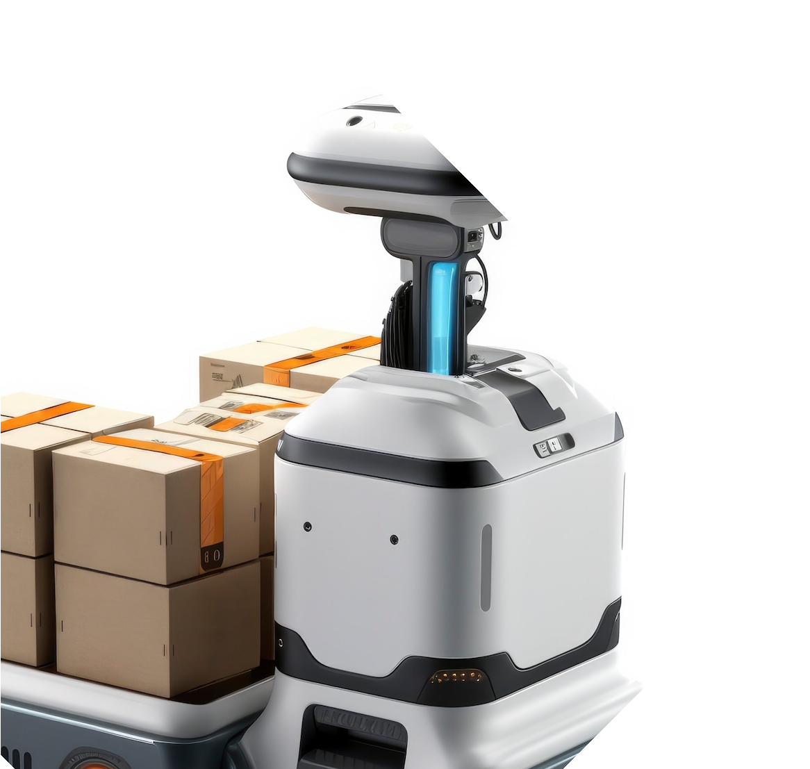

Real-World Applications
Integrate with BGU student App
Offer the app for hospitals and large public facilities
The Lost Student App's technology can be extended into many sectors like robotics, military, healthcare, and more

Slide 22
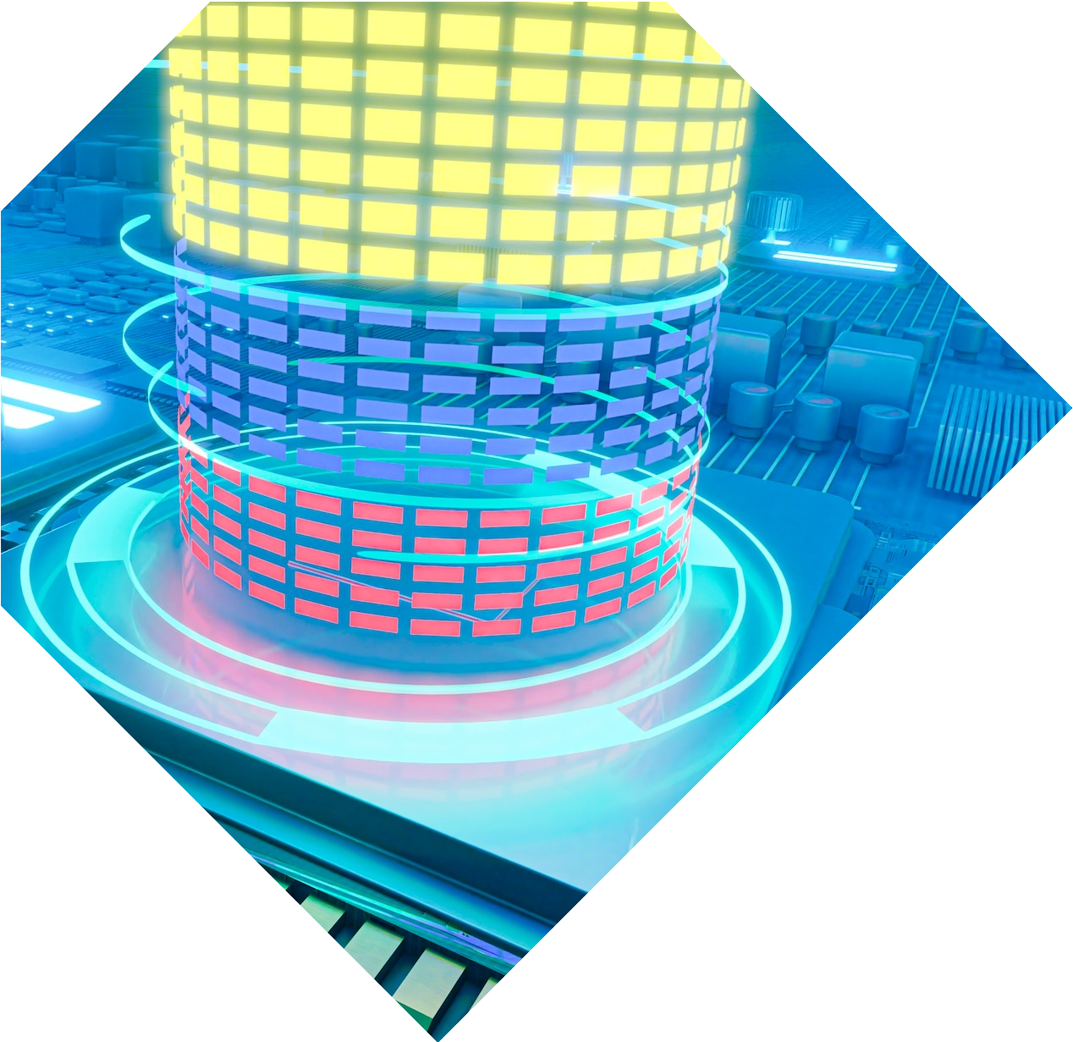
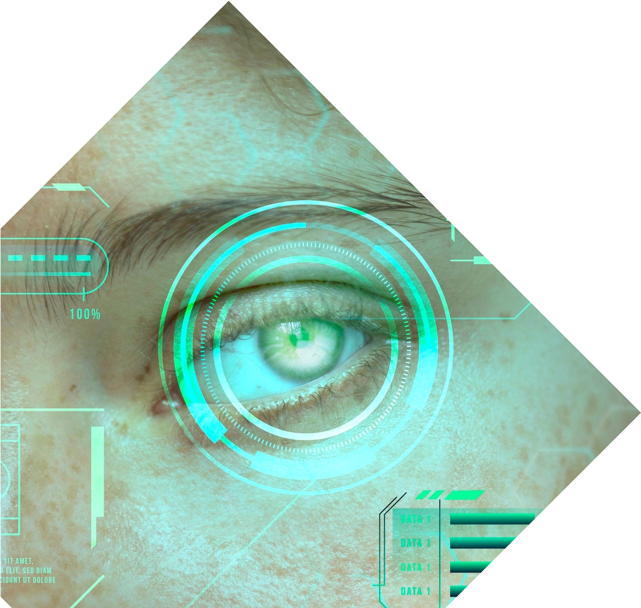
Future Directions
Improve the UI
Shorten computation time
Integrate with BGU app
Integrate the app with google maps

Slide 23
Conclusion
We solved a Real Life problem
We used a cross platform App and Computer Vision Algorithms
We enjoyed the process of learning
Now it’s time for you to use the app:
“Embark on a seamless journey through campus with the Lost Student App, your trusted companion for effortless navigation and image-based localization.”

Slide 24
Thanks!
Do you have any questions?
ronkh@post.bgu.ac.il, amoyalr@post.bgu.ac.il, omrihir@post.bgu.ac.il
Our App
GitHub

